Slide 1
Implementing Peer Code Reviews
Anton Nielsen, VP (Chief Mentoring Officer)
anielsen@insum.ca

Slide 2
Agenda
Why Do Code Reviews?
Document Your Goals
Document Coding Standards
Make it Light Weight
Use Automated Tools
Use Checklists
Not Every Defect Gets Fixed
Assess Results and Make Improvements
Review of Code Review Artifacts

Slide 3
Why Do Code Reviews?
Improve Quality
Why Peer Code Reviews?
Efficient
Educational
Leverage and broaden skillsets
Good for morale
Save $

Slide 4
Document Your Goals
Why is YOUR organization doing peer code reviews?
Survey says
Improve Quality
Reduce time to implement new features
Happier Customers / Users
Improve Developer Skills
Reduce Risk (employee wins the lottery)
Improve Moral

Slide 5
Document How You Measure Success
Use Real Measurements for Meaningful Business Goals
Within the next 12 months…
Reduce post deployment support calls by 10%
Increase team velocity by 15%
Improve Net Promoter Score by 20%
Report on Results – Demonstrate Value

Slide 6
Establish a Culture…
Where everyone is a developer.
Where everyone is responsible for QA.
Where everyone gets an opportunity to do something fun, and everyone does the work no-one wants to do.
Where finding defects is celebrated.
Where measurement focuses on improvement (not blame).
Where success (including finding defects!) is celebrated.

Slide 7
Have a Kickoff Event
Have food at the event.
Have SWAG.
This deck is a reasonable start.
Improve your code review process and artifacts over time.
Have a Refresher Event
Have food at the event.
Celebrate your success. Have SWAG.
Review the new artifacts and processes.
Improve your code review process and artifacts.
Have a Refresher Event
Have food at the event.
Celebrate your success. Have SWAG.
Review the new artifacts and processes.
Improve your code review process and artifacts.

Slide 8
Document (and USE!) Coding Standards
Specific to your organization—and be specific!
Don’t rewrite best practices
Provide time for new developers to review standards and regular discussion opportunities.
Regularly review your standards.
Developers will only see value if senior leadership demonstrates interest by spending time on these artifacts.
Build documentation that has long term use
Require self-documenting code
Capture requirements within the online help
Upcoming Blog Posts
Goals
Ease maintenance and transition
Instantiate what is unique and important

Slide 9
Specific Coding Standards (APEX Examples)
Applications subscribe to the “Insum LDAP” authentication scheme from application 876
Every page has an authorization scheme
Templates, LOVs, Auth Schemes, and other shared components are subscribed to from app 876, the ”Common Application”
Only use approved plugins stored in app 876 (and…this is the procedure to get a new plugin approved)
Use declarative Dynamic Actions
If you can’t, use documented APEX Javascript APIs
If you can’t, use JQuery APIs
Only then, custom crafted Javascript
Use Bind Variable Syntax!

Slide 10
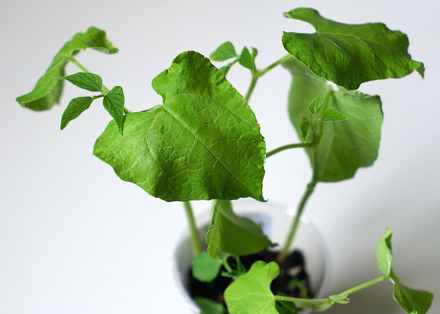
Make it Light Weight
The case for lightweight code reviews.
The magic of the potted plant.
Keep it short.
Publish and use an agenda.
Better too many, too soon, than too few, too late.

Slide 11
Sample Agenda - Maximum Time
Review automated code review results – 4 minutes
Turn on camera, talk about the weather, kids, etc – 4 minutes
Discuss and Demonstrate the functionality without looking at any code – 10 minutes
Review code, utilizing a checklist - 18 minutes
Review code fixed during the review* - 4 minutes
Document Results and Create New Stories – 3 minutes
Document how to improve code reviews – 2 minutes
Total time: 45 minutes
* The ability for developers and reviewers to fix minor errors, e.g. spelling mistakes, improves efficiency.

Slide 12
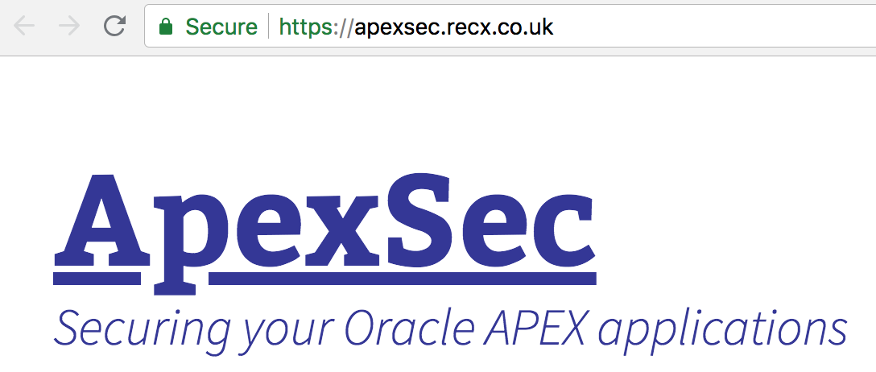
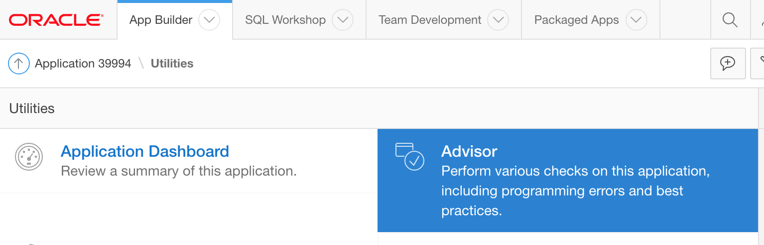
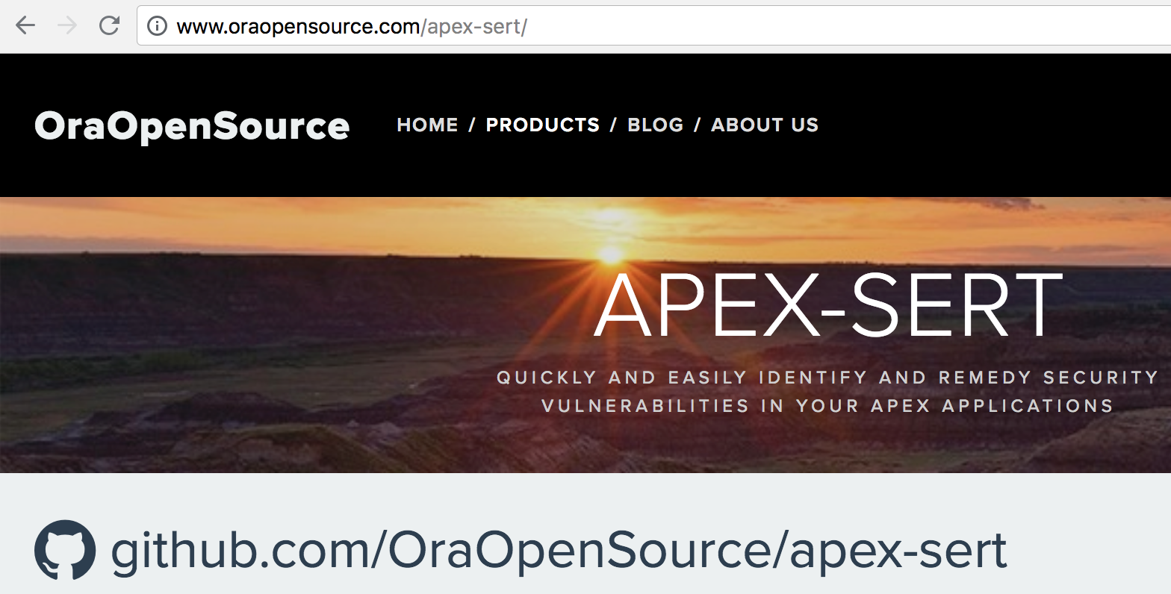
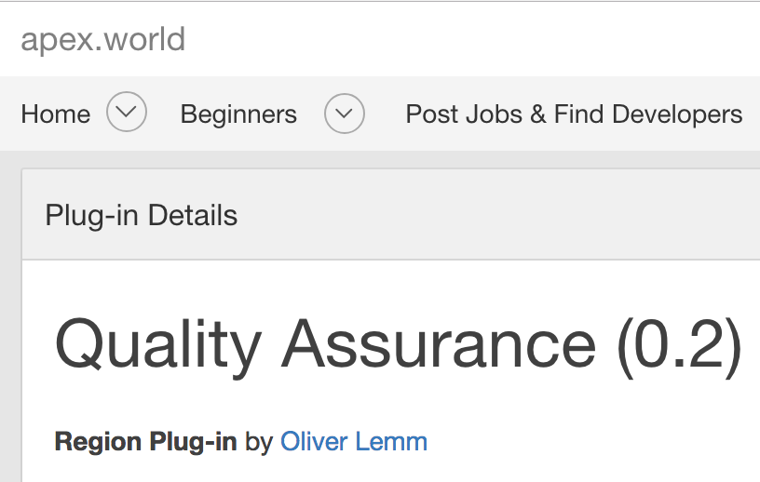
Automated Reviews

Slide 13
Use Checklists
Use something!
Spreadsheet, APEX Application, Websheet (yes, I said it)
Make it specific to APEX and to your development requirements.
Capture the results somewhere, somehow, across all code reviews.
Usually, the goal is not to catch every possible defect, but to efficiently and significantly improve quality.

Slide 14
Sample Checklist
Can the primary developer describe the functionality with precision and certaintly?
Does the help text fully and accurately reflect the requirements and the functionality?
Is the business logic in pl/sql packages?
Is proper bind variable/substitution syntax? (This should be automated but is worth repeating.)
Are procedures self-documented?
Run the page in debug mode for rendering and review.
Review the two longest running components for obvious improvements
Repeat step 6 for page submission.
Have the primary developer walk through all code, highlighting interesting or difficult aspects.
Review all Dynamic Actions (DA) that make AJAX calls (generally pl/sql DAs). Confirm that they are not fired for every row of a report.
Review all DAs that are not declarative--APEX, JQuery, hand-crafted
Developer’s Choice
Reviewers Choice

Slide 15
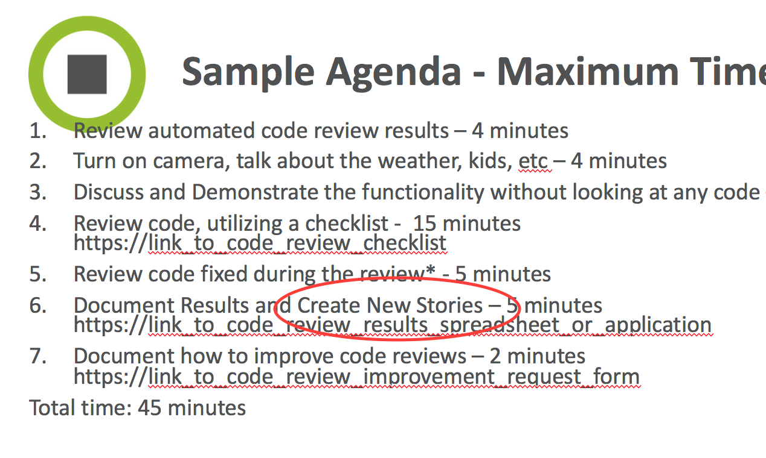
Not Every Defect Gets Fixed
…or even found.
At least not today…
Empower the developer and reviewer to make the call or to engage the product owner when in question.

Slide 16
Assess Results and Make Improvements
Keep track of defects by category
# found and fixed during the review (or immediately after)
# that require fixing prior to release with another review
# that end up as new stories
Embrace the Code Review Culture
Finding “Defects*” is GOOD!
*Finding issues before they become production bugs!

Slide 17
Code Review Artifacts
Documented Goals
Defined metrics that support those goals
A Kickoff Deck to Support a Fabulous Kickoff Event
Coding Standards
Code Review Checklist
Location to log # defects found in the code review by category
Location/method to request improvements to artifacts
An agenda that includes links to the items above

Slide 18
Start Tomorrow!
Even if you don’t have every artifact available, begin your process as soon as possible.
Starter Application:
https://github.com/ainielse/rando/
Demo:
https://dev.insumlabs.com/webappsdev/f?p=peer_review

